Slide 1


●●●●●●●●●●●●●●●●●●●●●●●●●●●●●●●●●●●●●●●●●●●●●●●●●●
●●●●●●●●●●●●●●●●●●●●●●●●●●●●●●●●●●●●●●●●●●●●●●●●●●
Optimal state estimation
Ruijie Wang

Slide 2

●●●●●●●●●●●●●●●●●●●●●●●●●●●●●●●●●●●●●●●●●●●●●●●●●●
●●●●●●●●●●●●●●●●●●●●●●●●●●●●●●
●●●●●●●●●●●●●●●●●●●●●●●●●●●●●●
Least squares estimation
foreword

Slide 3

01
Estimation of a constant
02
Weighted least squares estimation
03
Content
Recursive least squares estimation
04
●●●●●●●●●●●●●●●●●●●●●●●●●●●●●●●●●●●●●●●●●●●●●●●●●●
Wiener filtering
05
Summary

Slide 4


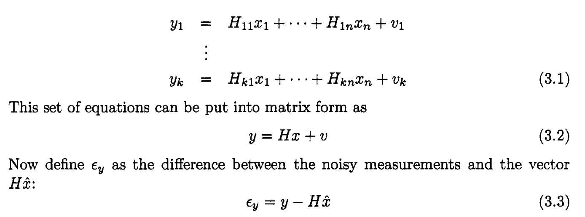
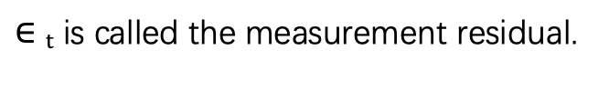
1. Estimation of a constant
how to estimate a constant on the basis of several noisy measurements of that constant.
$∈t$ is called the measurement residual.

Slide 5
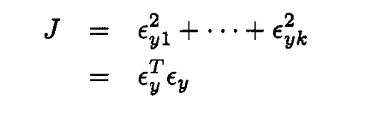
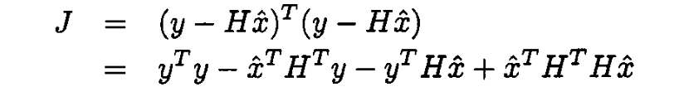
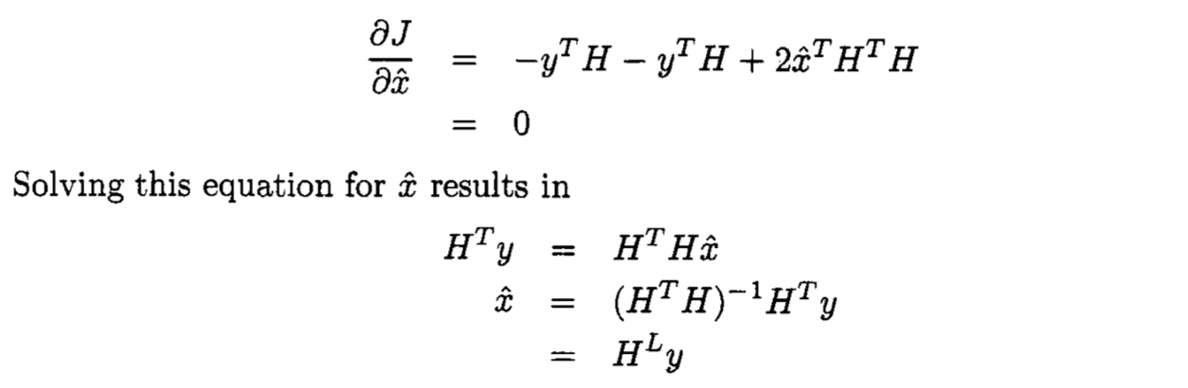

1. Estimation of a constant
Replace $∈$
Where H^{L}, the left pseudo inverse of H, exists if k≥n and H is full rank.

Slide 6
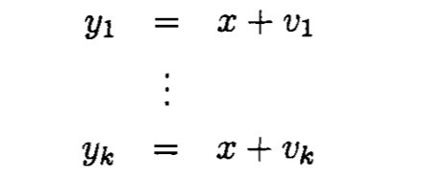
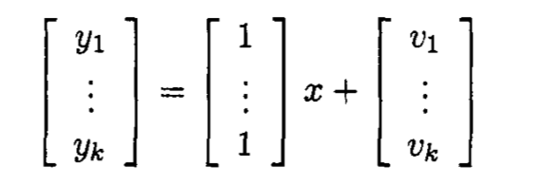
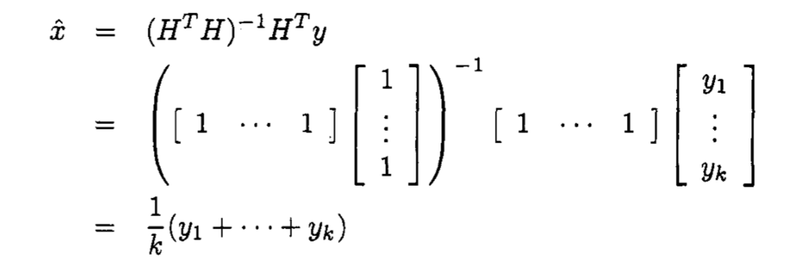
1. Estimation of a constant
These k equations can be combined into a single matrix equation as
In this simple example, we see that least squares estimation agrees with our intuition to simply compute the average of the measurements.

Slide 7
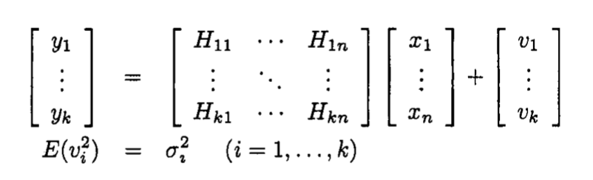
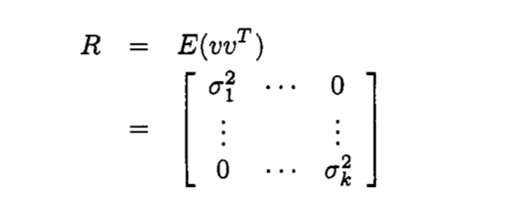
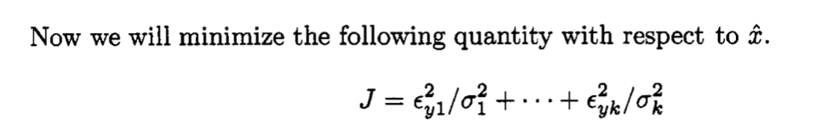
2. WEIGHTED LEAST SQUARES ESTIMATION
x : a constant but unknown n-element vector
y : a k-element noisy measurement vector.
We assume that each element of y is a linear combination of the elements of x, with the addition of some measurement noise, and the variance of the measurement noise may be different for each element of y:
covariance matrix

Slide 8
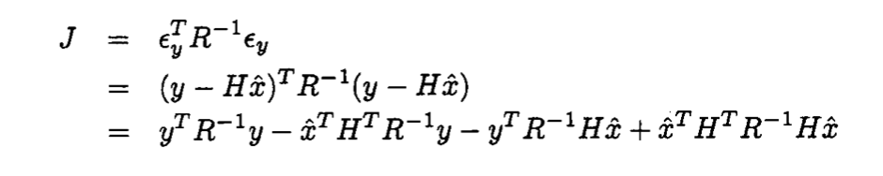
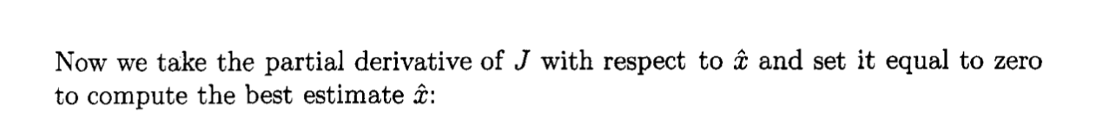
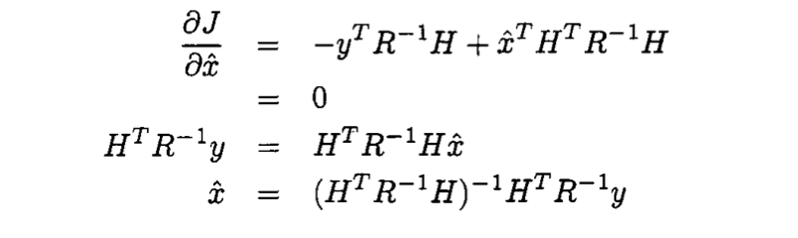
2. WEIGHTED LEAST SQUARES ESTIMATION
Note： that this method requires that the measurement noise matrix R be nonsingular. In other words, each of the measurements y_{i} must be corrupted by at least some noise for this method to work.

Slide 9
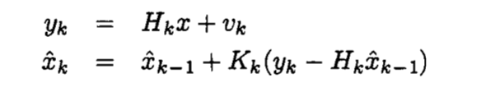
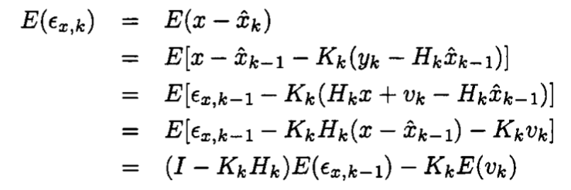
3. RECURSIVE LEAST SQUARES ESTIMATION
A linear recursive estimator can be written in the form
K_{k} is a matrix to be determined called the estimator gain matrix.
The quantity (yk-H_{k}x_{k-1}) is called the correctionterm.
Before we compute the optimal gain matrix K_{k}, let us think about the mean of the estimation error of the linear recursive estimator. The estimation error mean can be computed as

Slide 10
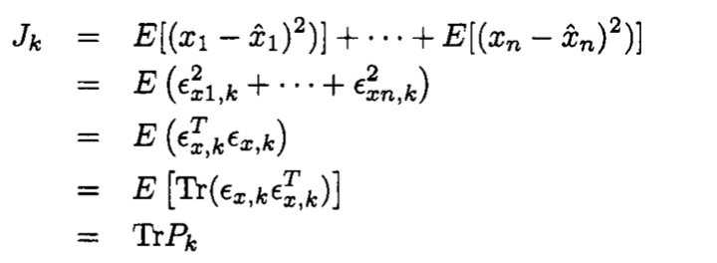
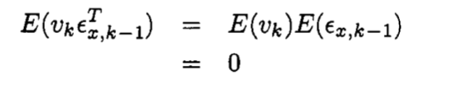
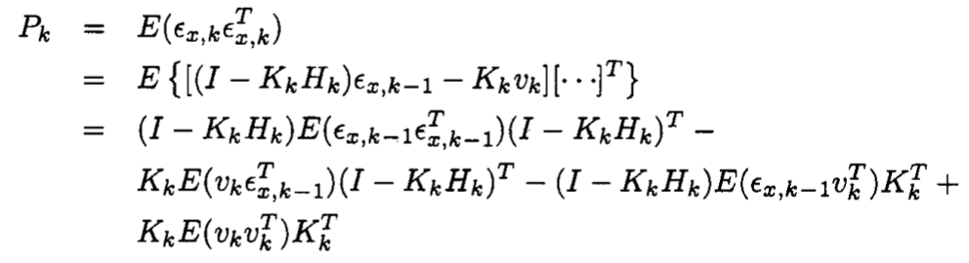
3. RECURSIVE LEAST SQUARES ESTIMATION
minimize is the sum of the variances of the estimation errors at time k:
where R_{k} is the covariance of v_{k}
P_{k} will be positive definite, assuming that P_{k-1} and R_{k} are positive definite.

Slide 11
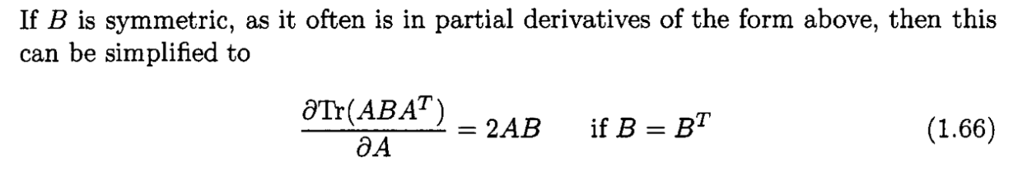
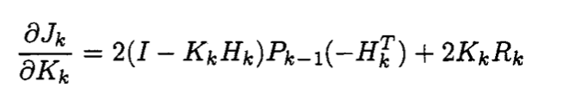
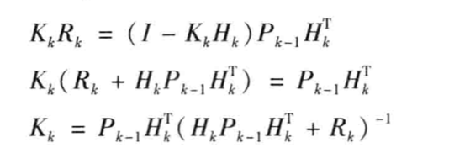
3. RECURSIVE LEAST SQUARES ESTIMATION
From Ch1-page17

Slide 12
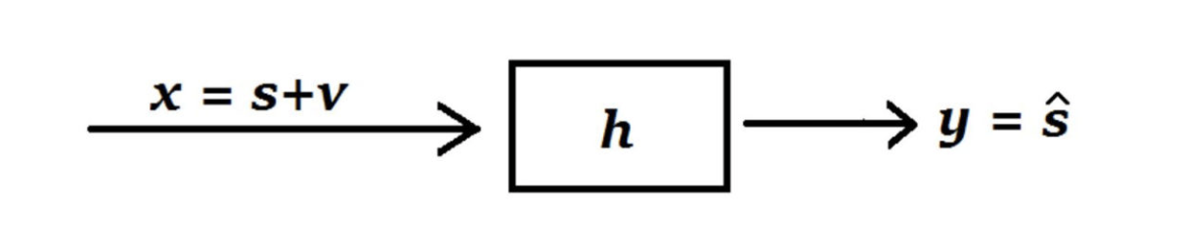
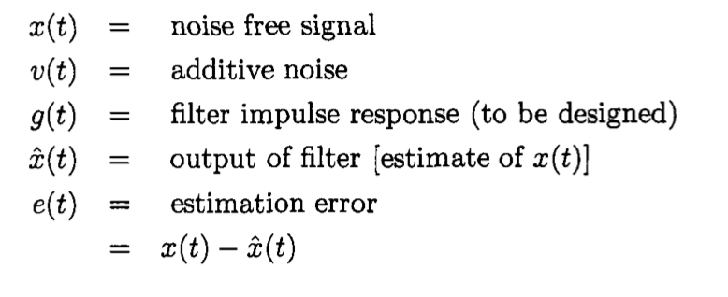
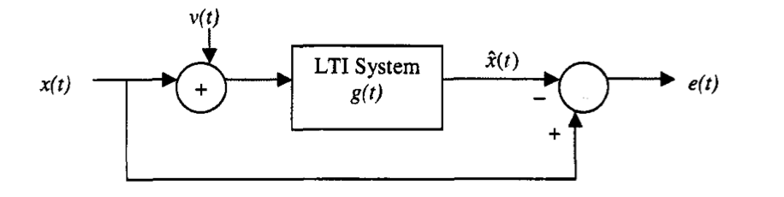
4. WIENER FILTERING
Wiener filter mainly designs a linear time-invariant filter from the frequency domain point of view to extract the signal from the noise
The essence of Wiener Filtering is to minimize the mean square of estimated error, defined as the difference between the expected response and the filter's actual output

Slide 13
4. WIENER FILTERING
To set up the presentation of the Wiener filter, we first need to ask the following question: How does the power spectrum of a stochastic process x(t) change when it goes through an LTI system with impulse response y(t)?
y(t)=h(t)∗x(t)+n(t)
y(t)=g(t)∗x(t)
The output y(t) of the system is given by the convolution of the impulse response with the input

Slide 14
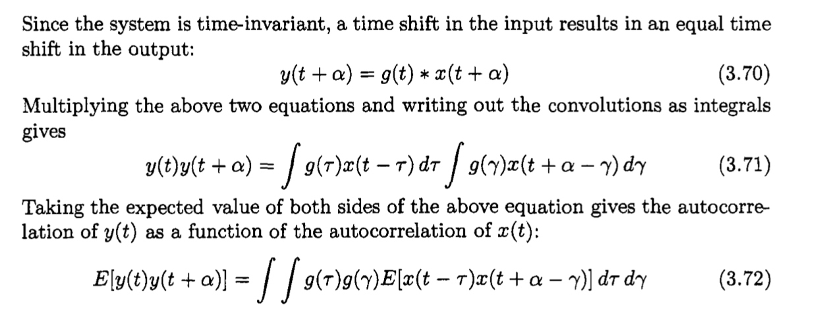
4. WIENER FILTERING

Slide 15
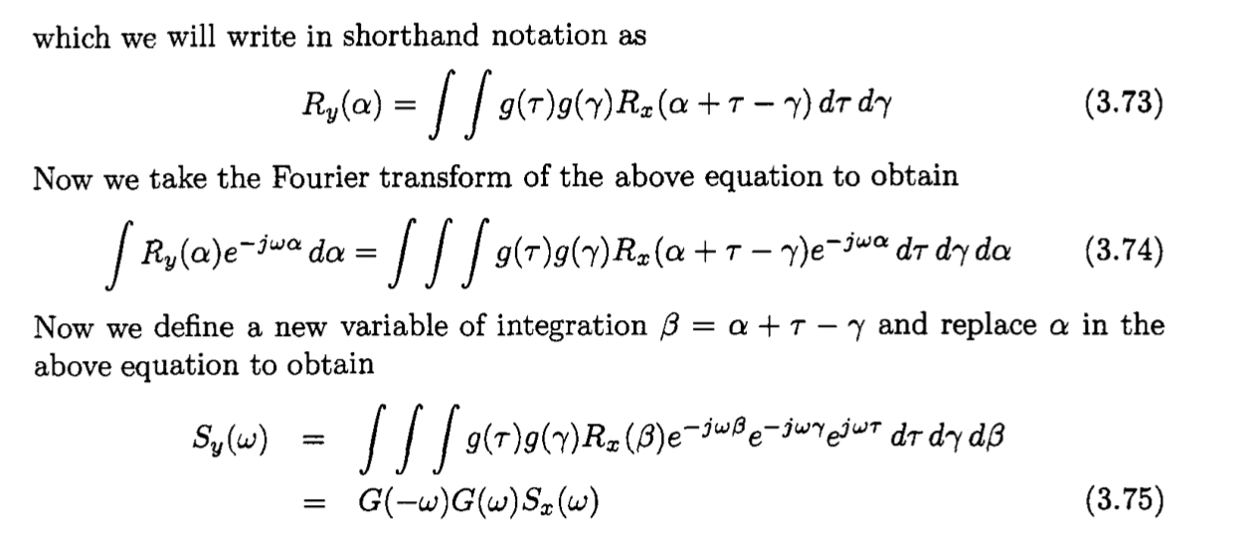
4. WIENER FILTERING

Slide 16
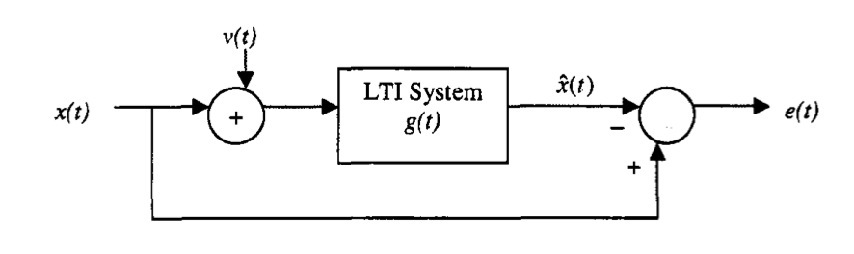
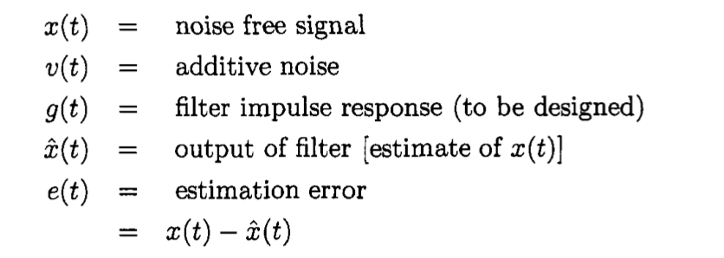
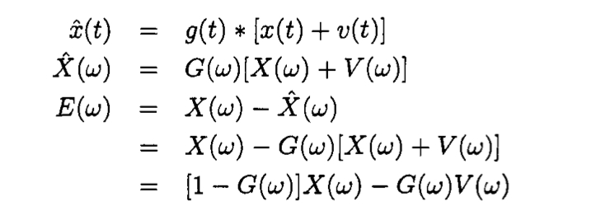
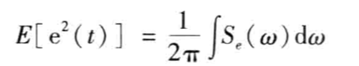
4. WIENER FILTERING
We see that the error signal e(t)is the superposition of the system [l-G(w)] acting on the signal x(t),and the system G(w) acting on the signal v(t). Therefore, we obtain
（By LSE）

Slide 17
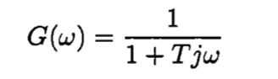
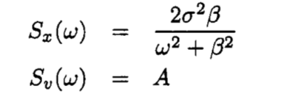
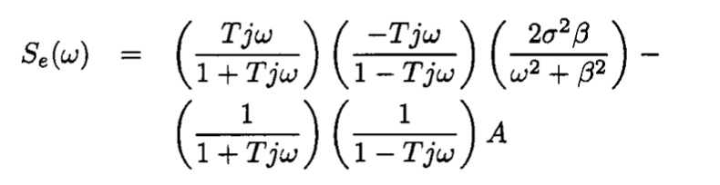
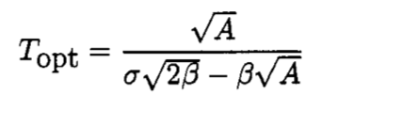
4. WIENER FILTERING
In order to simplify the problem of the determination of the optimal filter G(w), we can assume that the optimal filter is-a first-order, low-pass filter (stable and causal) with a bandwidth 1/T to be determined by parametric optimization.
This may not be a valid assumption, but it reduces the problem to a parametric optimization problem. In order to simplify the problem further, suppose that S_{x}(w) and S_{v}(w) are in the following forms
In other words, the noise w(t) is white. we obtain

Slide 18
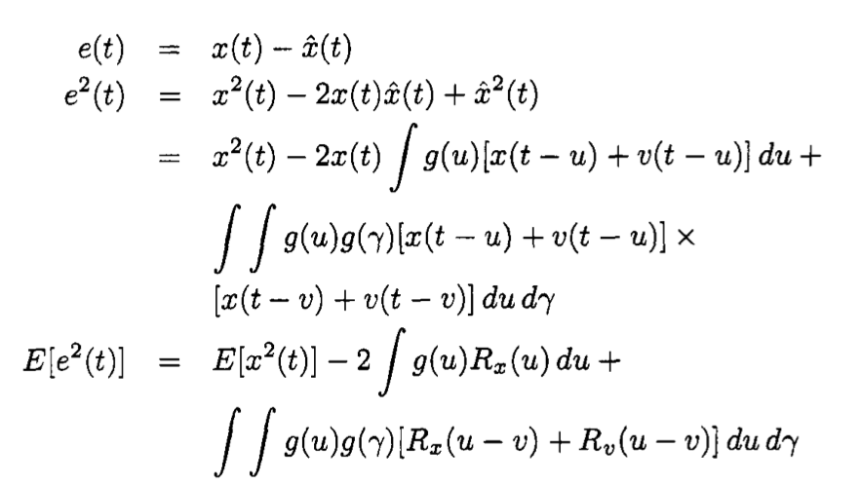
4. WIENER FILTERING
Now we take a more general approach to find the optimal filter. The expected value of the estimation error can be computed as

Slide 19
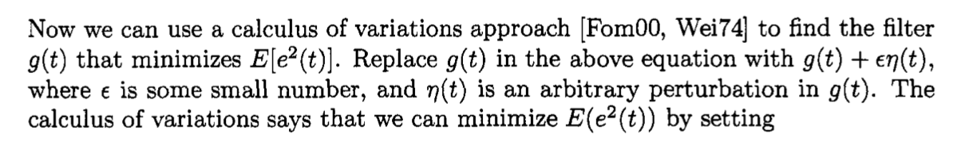
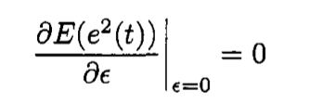
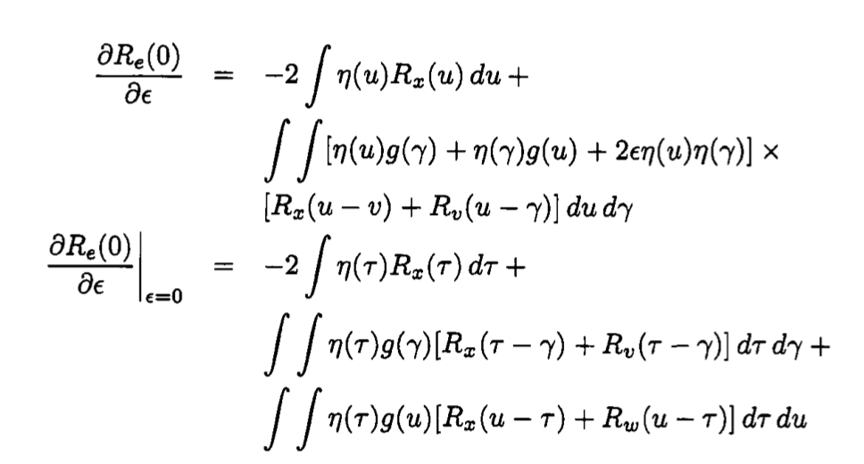
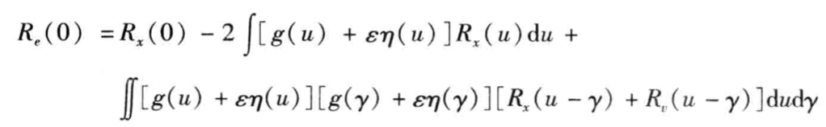
4. WIENER FILTERING
and thus solve for the optimal g(t)

Slide 20
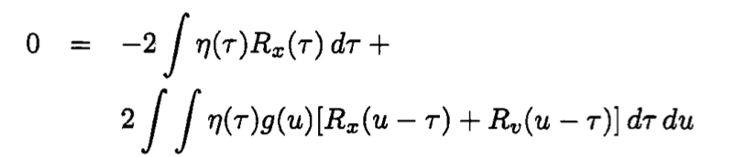
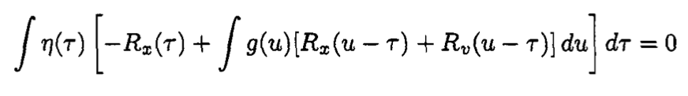
4. WIENER FILTERING
if x(t) is stationary. In this case, the above equation can be written as
This gives the necessary condition for the optimality of the filter g(t) as follows:
We need to solve this for g(t) to find the optimal filter.

Slide 21
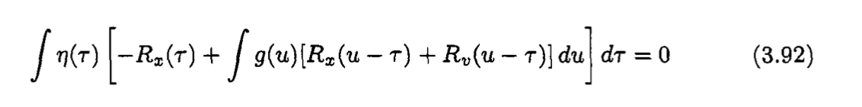
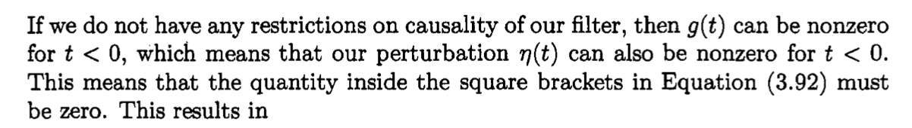
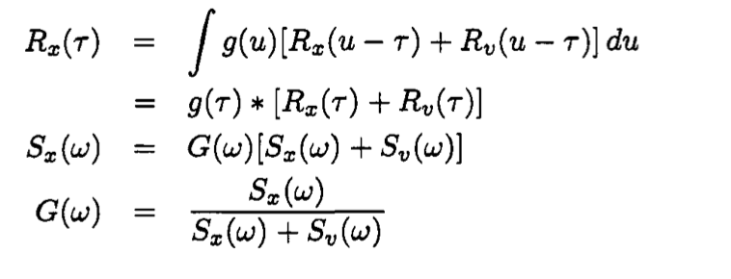
4. WIENER FILTERING
Noncausal filter optimization
The transfer function of the optimal filter is the ratio of the power spectrum of the signal x(t)to the sum of the power spectrums of x(t)and the noise v(t).

Slide 22
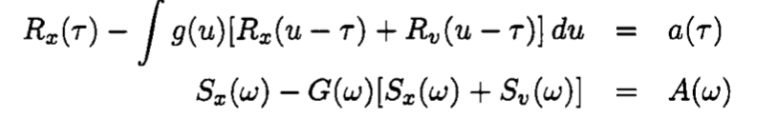
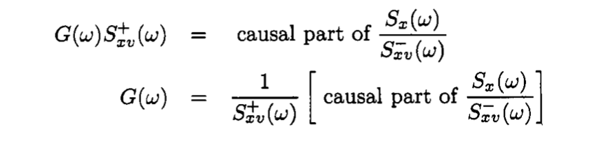
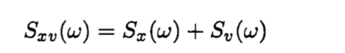
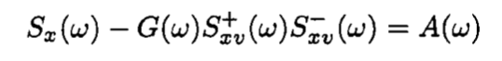
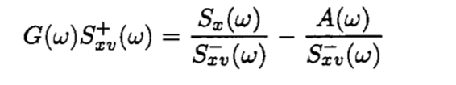
4. WIENER FILTERING
Causal filter optimization
Postulate some function a(t)that is arbitrary for t < 0, but is equal to 0 for t $≥$20. Then we obtain
This gives the TF of the optimal causal filter.

Slide 23

4. WIENER FILTERING
As expected, the estimation error decreases when we have fewer constraints on the filter. However, the removal of constraints makes the filter design problem more difficult. The Wiener filter is not very amenable to state estimation because of difficulty in extension to MIMO problems with state variable descriptions, and difficulty in application to signals with time-varying statistical properties.

Slide 24
●●●●●●●●●●●●●●●●●●●●●●●●●●●●●●●●●●●●●●●●●●●●●●●●●●
●●●●●●●●●●●●●●●●●●●●●●●●●●●●●●
●●●●●●●●●●●●●●●●●●●●●●●●●●●●●●
Propagation of states and covariances

Slide 25



1. DISCRETE-TIME SYSTEMS
Suppose we have the following linear discrete-time system:
where U_{k} is a known input and W_{k} is Gaussian zero-mean white noise with covariance Q_{k}.
the covariance of x_{k} change with time：

Slide 26

1. DISCRETE-TIME SYSTEMS
This is called a discretetime Lyapunov equation, or a Stein equation

Slide 27




2. SAMPLED-DATA SYSTEMS
The continuous-time dynamics are described as
From Chapter 1 we know that the solution of x( t )at some arbitrary time, say t_{k} , is given as
If we make the definitions
then Equation becomes

Slide 28




2. SAMPLED-DATA SYSTEMS
then Equation becomes

Slide 29





2. SAMPLED-DATA SYSTEMS

Slide 30

●●●●●●●●●●●●●●●●●●●●●●●●●●●●●●●●●●●●●●●●●●●●●●●●●●
●●●●●●●●●●●●●●●●●●●●●●●●●●●●●●●●●●●●●●●●●●●●●●●●●●
THANK YOU

